Slide 1

Suburban Dreams: The Rise of the Rental Market
Industry Project Group 40
Ingrid Freeman Phoebe Fan Clarissa Hew
Ngoc Duy Tran Yasa Tjoe

Slide 2





Our Team
CLARISSA
YASA
DUY
INGRID
PHOEBE
Loves cooking and sewing
Would talk about anything with anyone. Lives to eat (and drink), sleep is non-negotiable
If intelligence is a weapon, I’m unarmed
Loves a swim, playing footy, and making music with her friends
Loves to play violin and tennis, and enjoys having a swim
Notes:
(Clarissa)
(30 sec) – introduce what each person is saying

Slide 3
Forecasting the rental market in Victoria
INTRODUCING THE PROBLEM:
Ever-increasing cost of living in Australia
Slowing economic growth
Rising interest rates
→ Increasing rental population
KEY QUESTIONS:
Q1: Most important internal and external features in predicting rental prices?
Q2: Top 10 suburbs with highest predicted growth rate?
Q3: Most liveable and affordable suburbs?
Notes:
(50 sec)

Slide 4





PROJECT LOGISTICS
PROGRAMS & APPLICATIONS USED
Python
GitHub
COMMUNICATION
2 stand-ups per week:
1 weekly in-person
1 weekly zoom
Regular updates via Teams and Messenger
TIMELINE
Duration: 6 weeks (thus far)
Sprint 1
Sprint 2
Sprint 3
Sprint 4
Sprint 5
Sprint 6
Sprint 7
Data Acquisition
Preprocessing
Analysis & Visualisation
Machine Learning
Deliverables
~ 30 hrs ~ 36 hrs ~ 12 hrs ~ 24 hrs ~ 18+ hrs
Notes:
(20 sec)

Slide 5

ACQUISITION OF DATA

Slide 6
ACQUISITION OF DATA
RENTAL DATA
Sources: Collected from domain.com.au
Size: ~ 1,000,000 rows
Time range: 2017 – 2023
Internal Features
Features relating to properties (eg. No. of rooms, no. of bathrooms, etc.)
INFRASTRUCTURE DATA
Sources: Scraped and collected from many different sources
External Features
Schools
Hospitals
Public transport stops (bus, tram, train)
Open space (parks, forests, etc.)
Distance to CBD (from each property)
CENSUS DATA
Sources: Collected from ABS
External Features
Population by postcode
Median Income by postcode
Crime rate by postcode
Notes:
(Clarissa)
(30 sec)

Slide 7

DATA PIPELINE
Notes:
(Yasa)

Slide 8
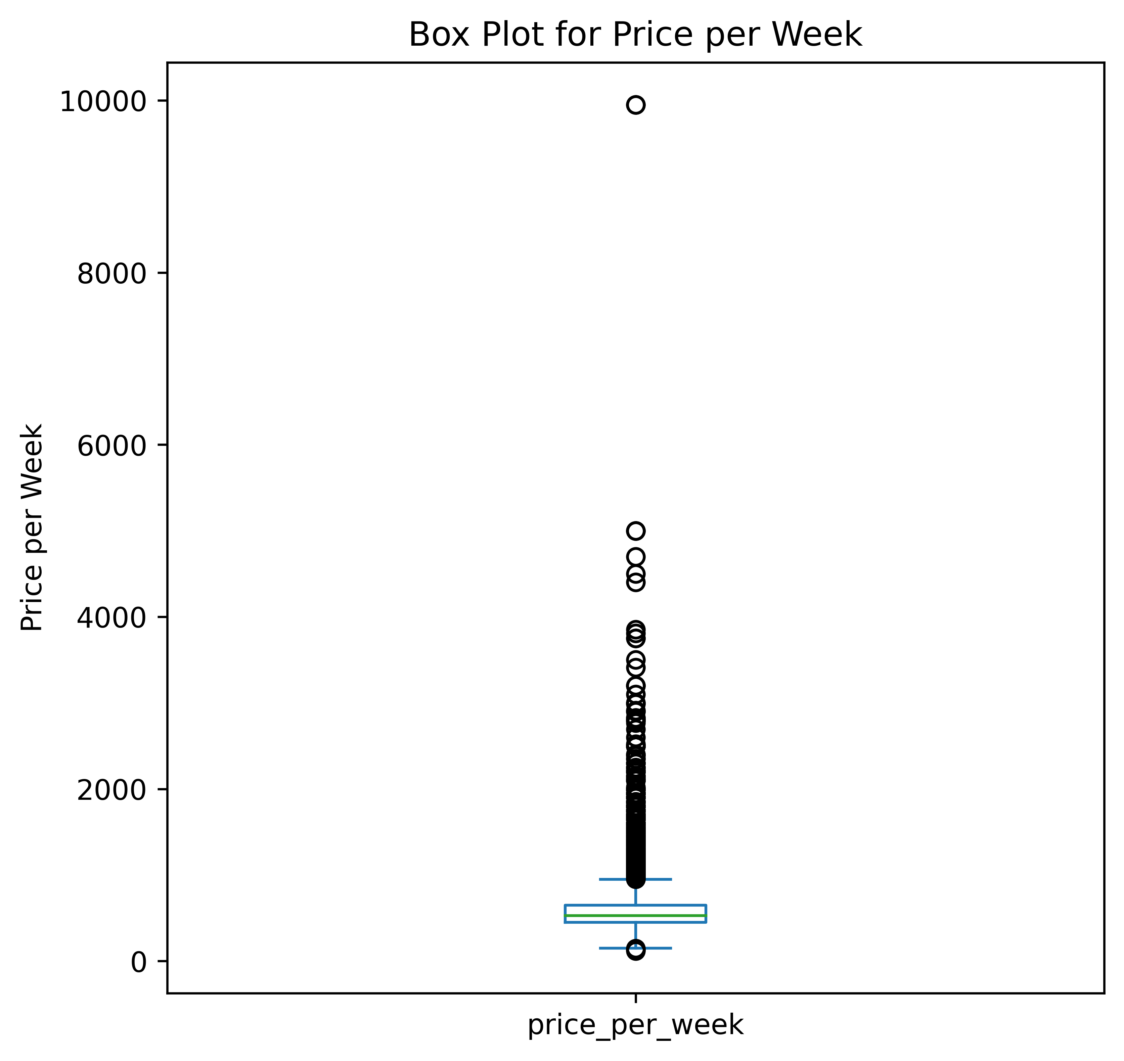
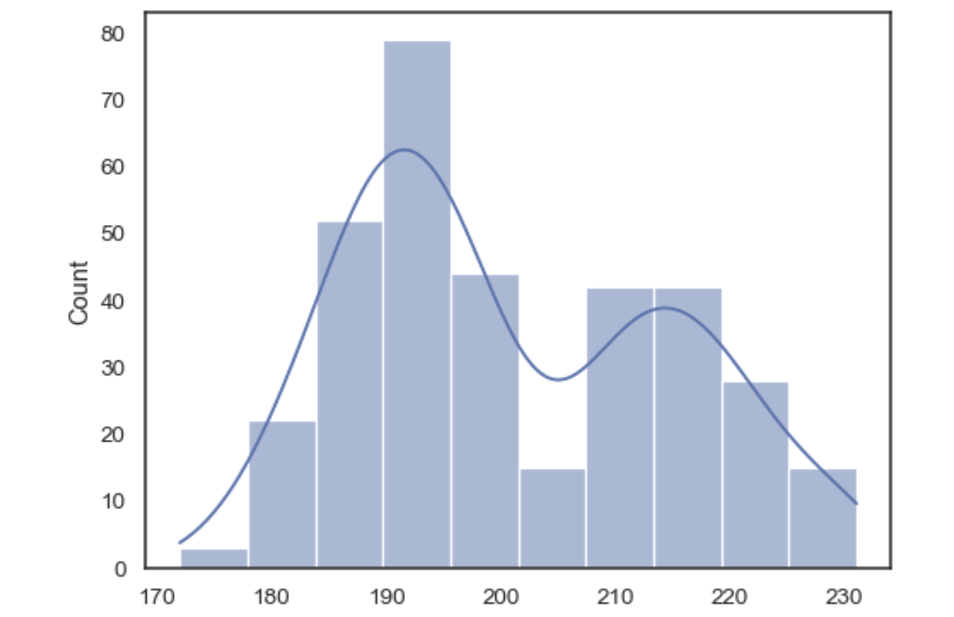
Data pipeline
Train with Lasso Regression and Light Gradient Boosting Methods
COLLECTION
Scraped and collected
OUTLIER DETECTION
IQR range
Web verification
DATA PARTITIONING
Train – test set
Information leak
Privacy requirement
Reasonable imputation
MODEL TRAINING
DATA IMPUTATION
LightGBM: a boosting algorithm that uses decision trees as its base learners, similar to Random Forest and XGBoost
 | Lasso | LGBM
MAE | 138.59 | 92.68
MSE | 91262.35 | 52919.78
MAPE | 0.2305 | 0.1466
Notes:
(20 sec)
In XGBoost, trees grow depth-wise, meaning that the algorithm grows the tree level by level 1. In contrast, LightGBM grows trees leaf-wise, meaning that it grows the tree by expanding the leaf with the maximum delta loss

Slide 9
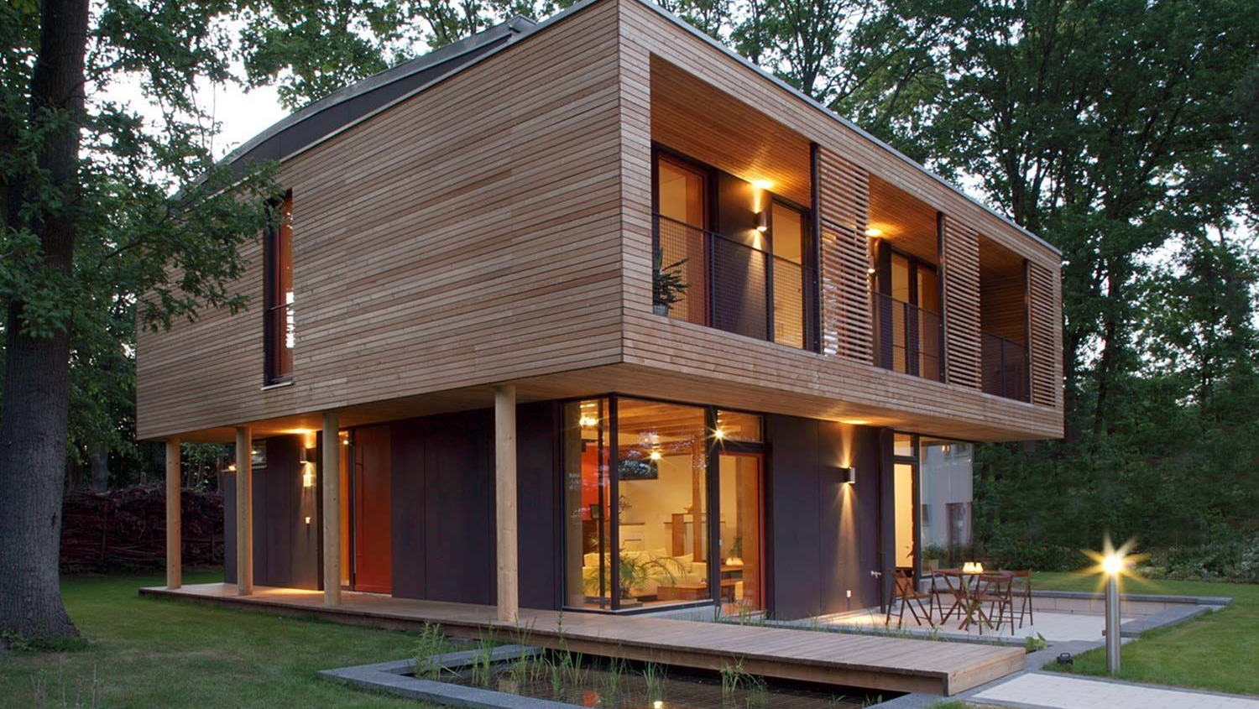
Determining factors of rental price

Slide 10
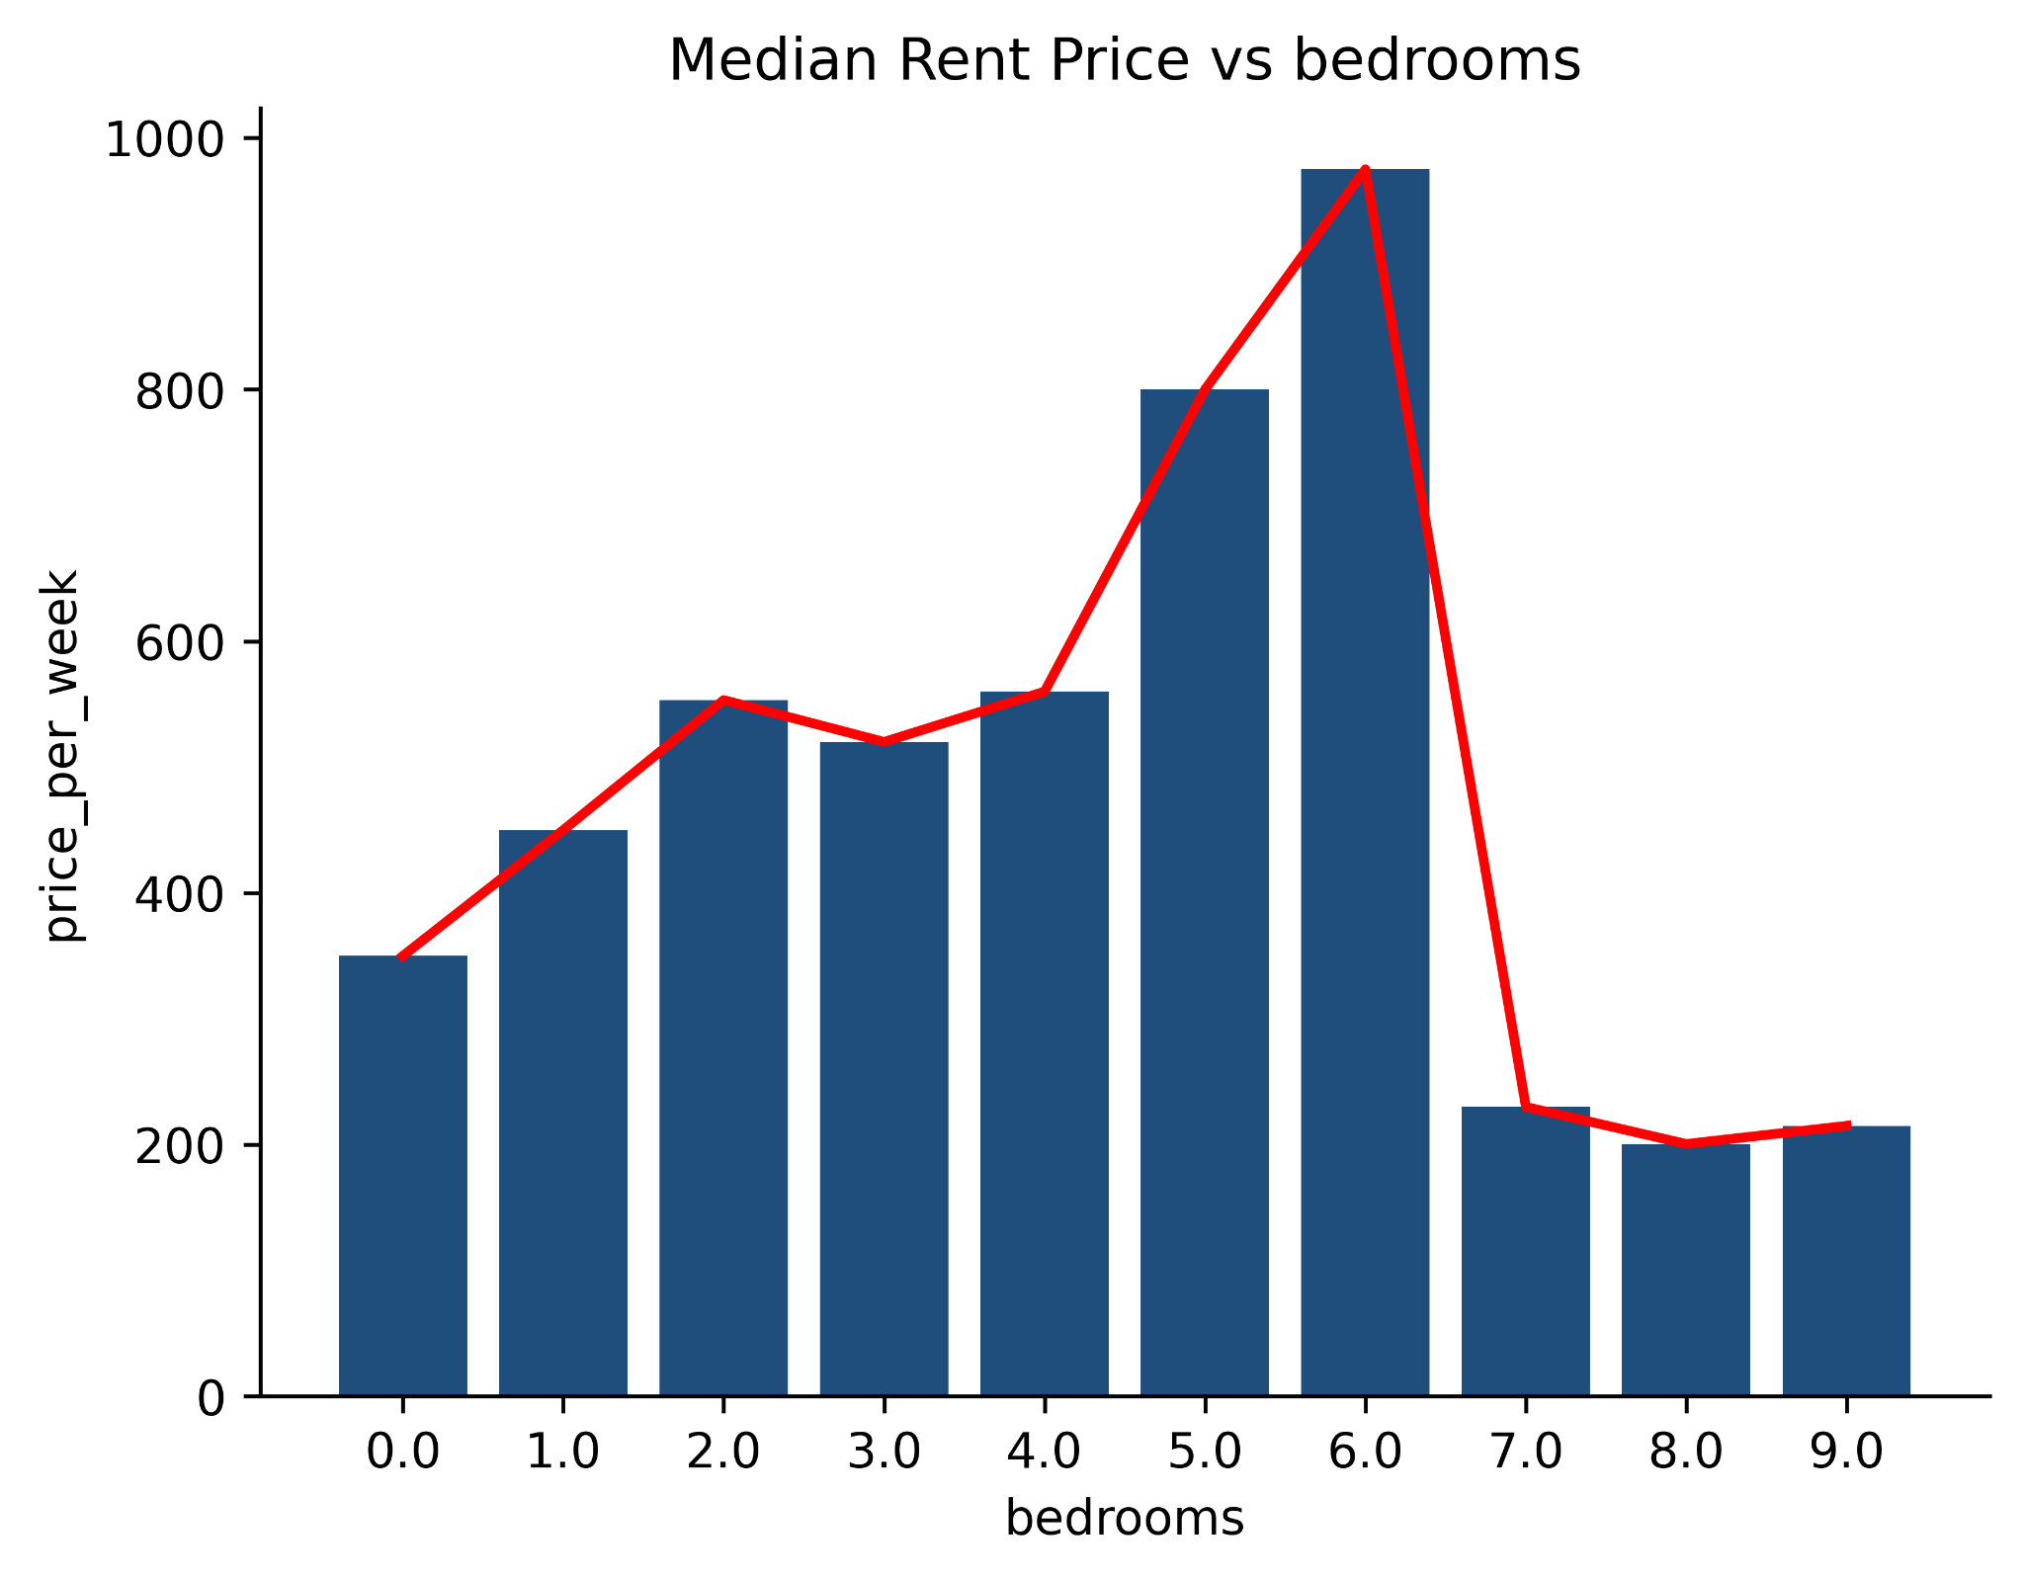
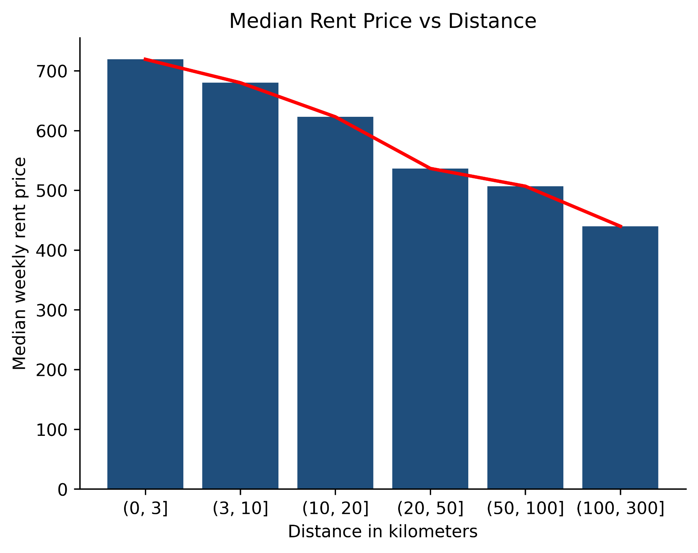

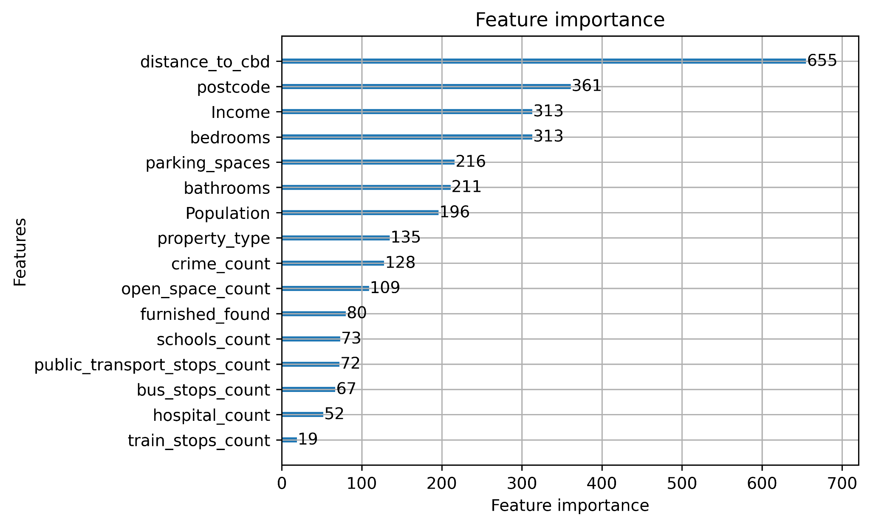
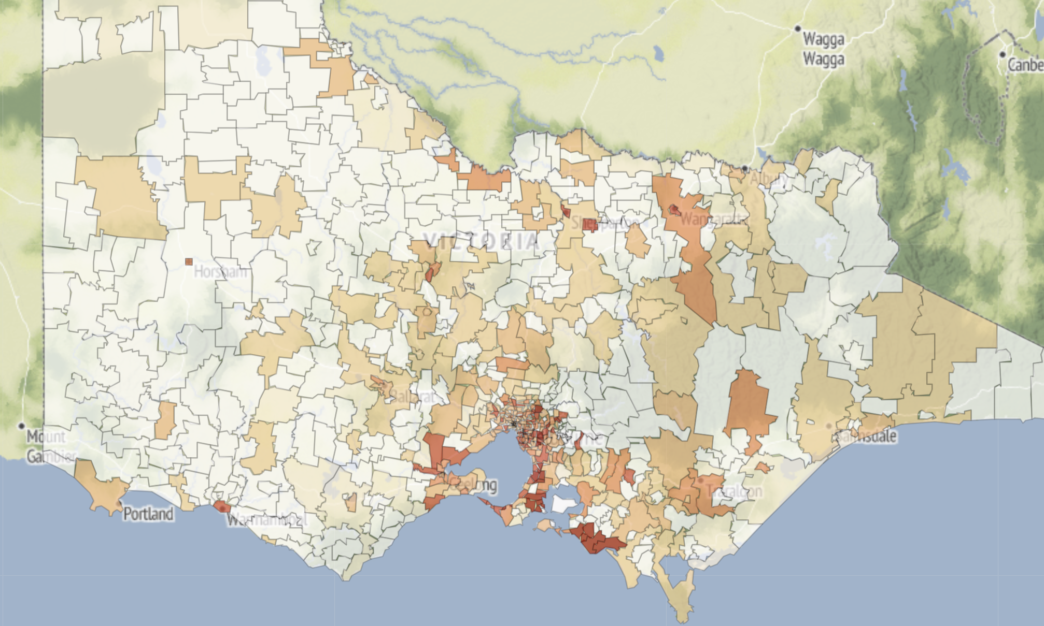



FEATURE PRIORITY
Distance to CBD
Far away from CBD ~ less expensive rent
Postcode
Some are much higher, and lower
Income
Affordability
Bedrooms
Bedrooms
More bedrooms ~ more area
More bedrooms ~ more area
Notes:
(Yasa)
(1 min)

Slide 11
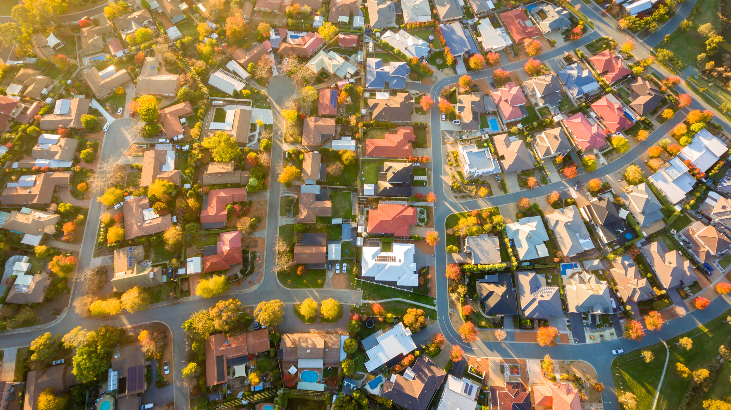
Suburbs rising in price
Notes:
(Ngoc)

Slide 12
PROPERTY GROWTH
STATISTICS
Assumption: Previous years’ data is highly useful for forecasting future growth
MACHINE LEARNING
Postcode | Population_2023 | Income_2023
3000 | 48623 | 1299
3132 | 17215 | 2120
3163 | 34144 | 2002
3844 | 31828 | 1608
3465 | 10038 | 943
Table: Population and income by postcode
Notes:
(30 sec)
A property can be divided into several categories; however, we're gonna focus on the 3 major markets: … accounting for 98% of the total transactions. In particular, draw an end-to-end analysis for the reason why some suburbs have higher rent predicted price in the future through an example of Dockalnds.
MACHINE LEARNING: these are the 3 columns extracted from 5 random rows of our real estate dataset. For 2026 predicted price, we'll replace the population and income in 2023 with the projected data in 2026 to find the new rental price for each real estate in 2026. Given the new price in 2026, aggregate by suburbs and compare the new price with price in previous years

Slide 13
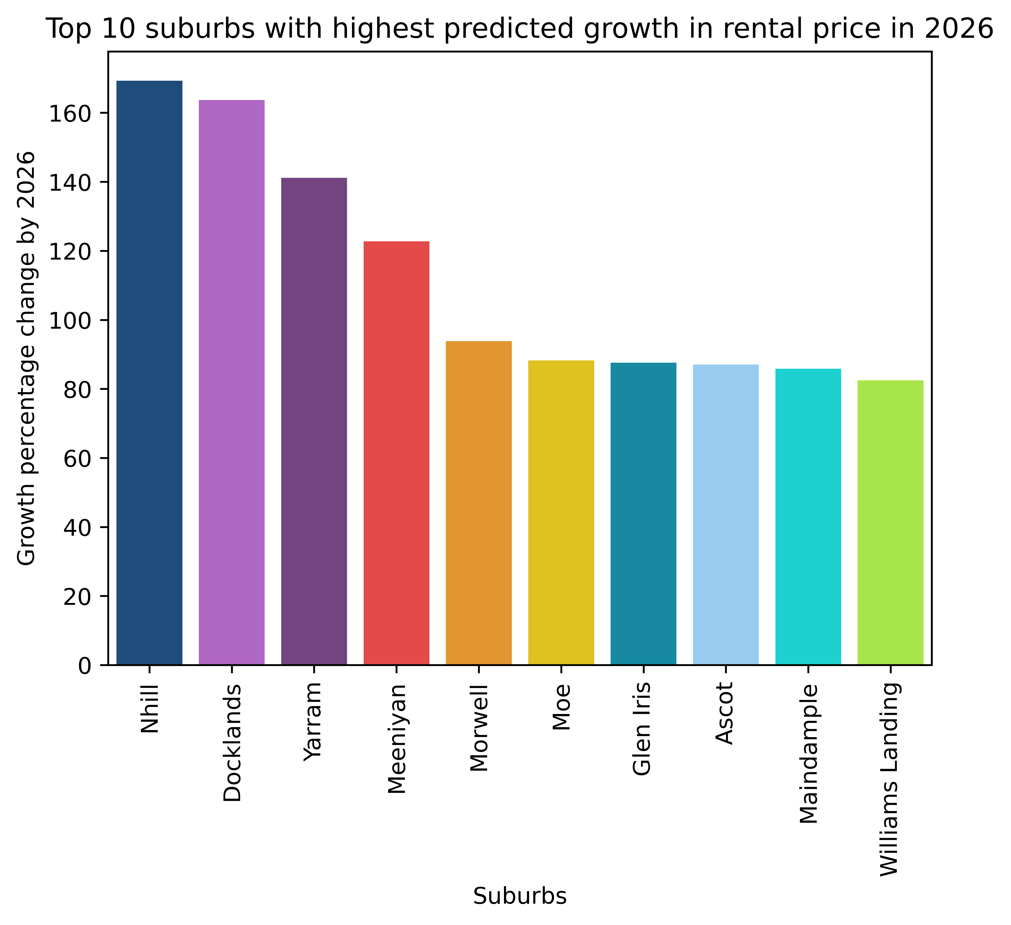
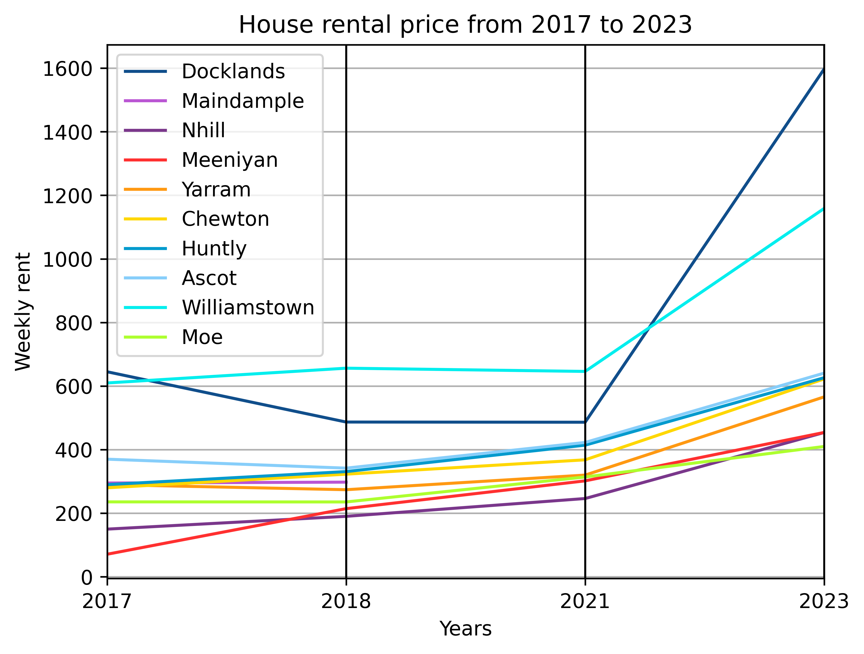

HOUSE GROWTH
STATISTICS
Assumption: Previous years’ data is highly useful for forecasting future growth
MACHINE LEARNING
7 Overlapping Suburbs: Docklands, Nhill, Meeniyan, Yarram, Ascot, Maindample, Moe
Notes:
(20 sec)

Slide 14
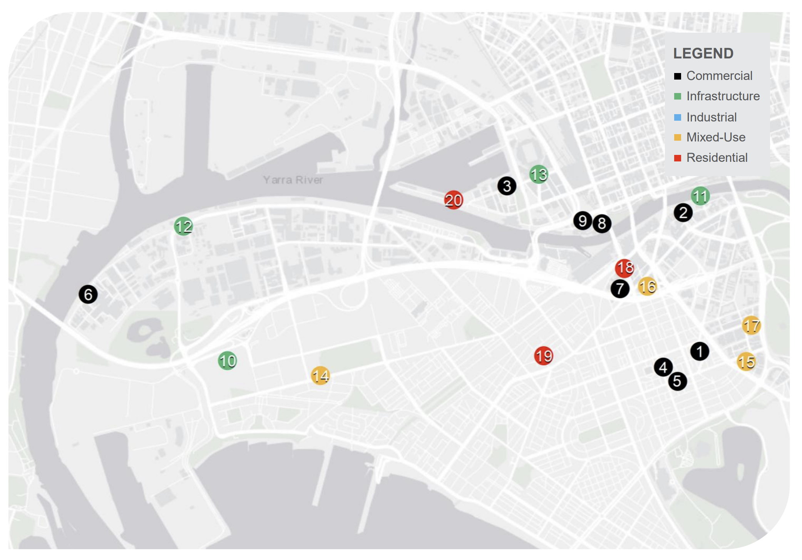
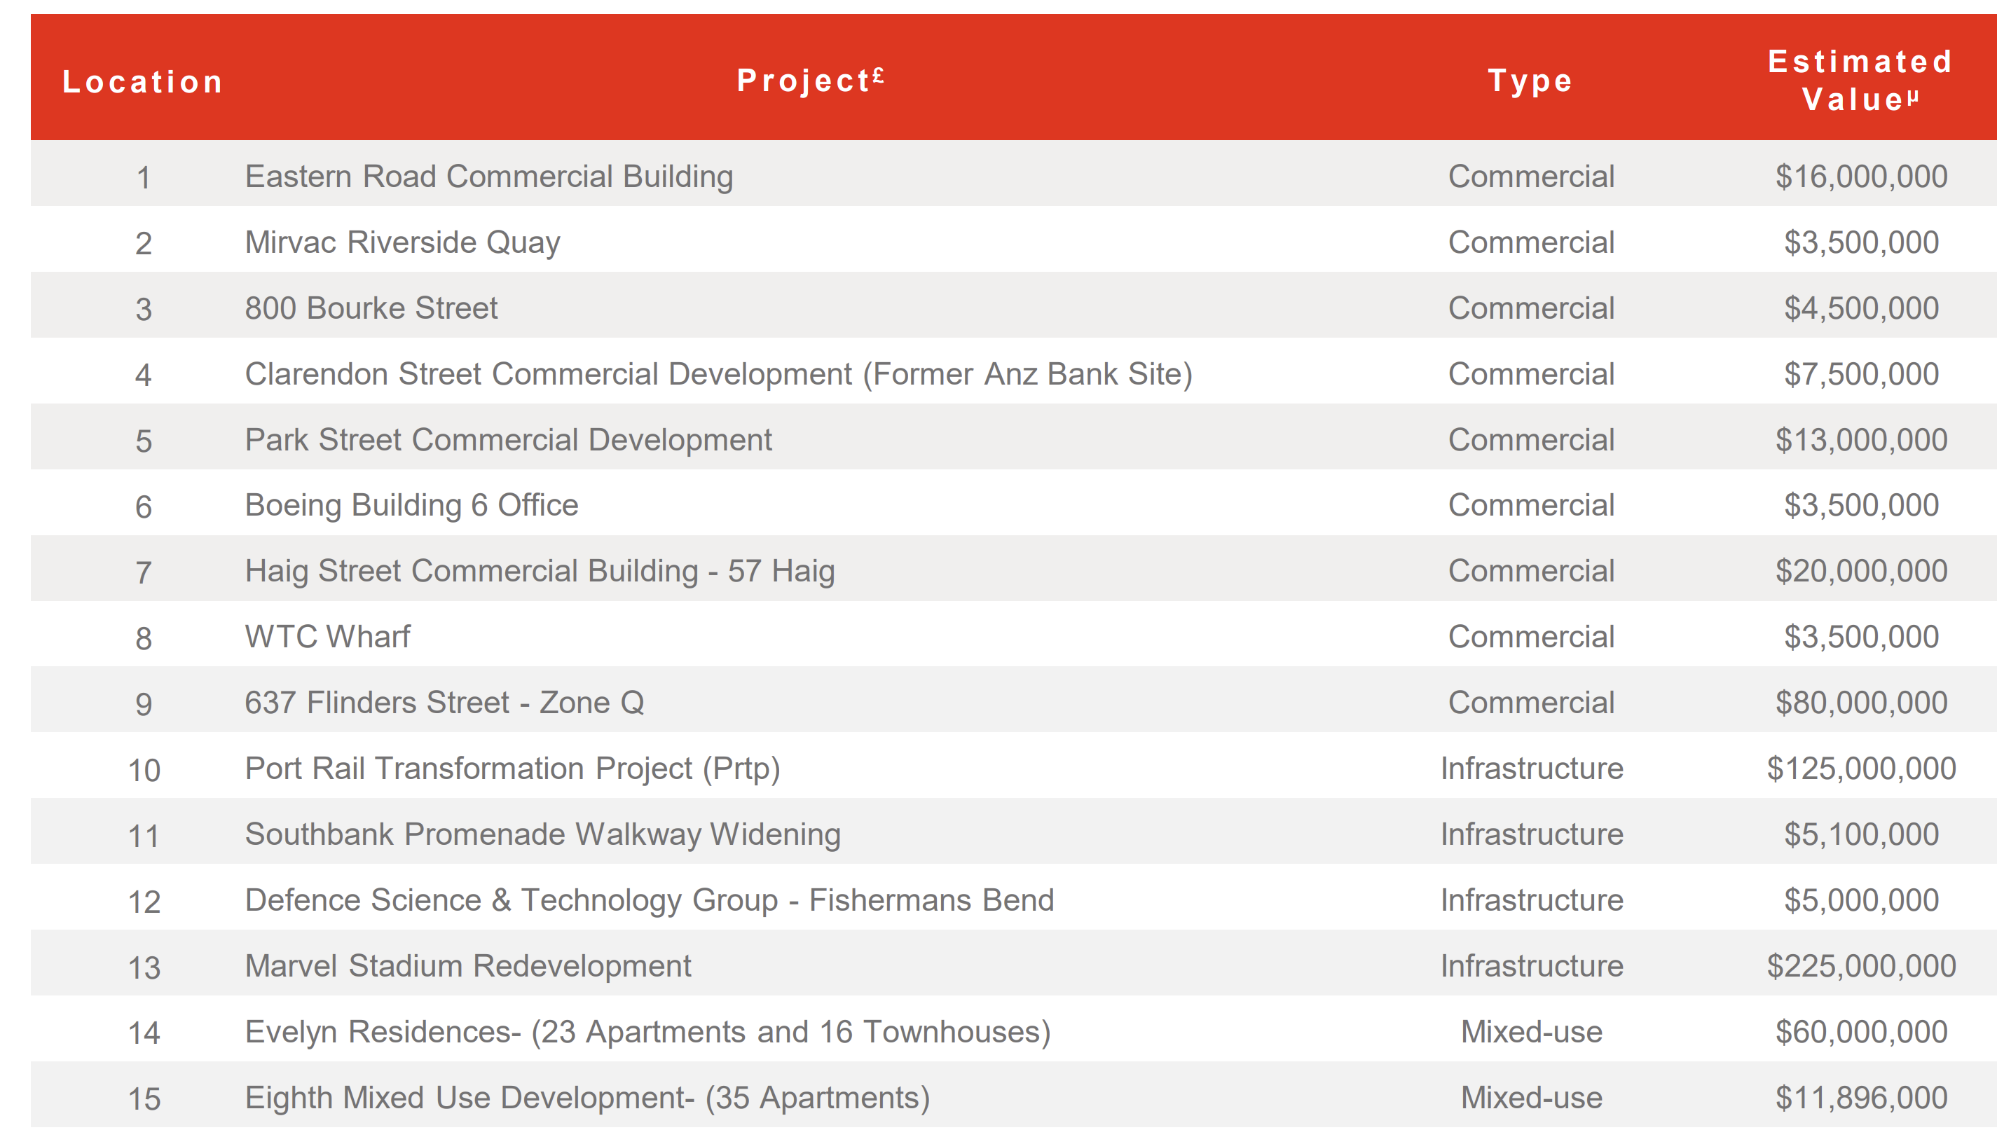
JUSTIFICATION FOR Higher predicted growth (docklands)
BASED ON INTUITION:
Effective Urban Planning
BASED ON ML:
Population
Income
Notes:
(30 sec)

Slide 15
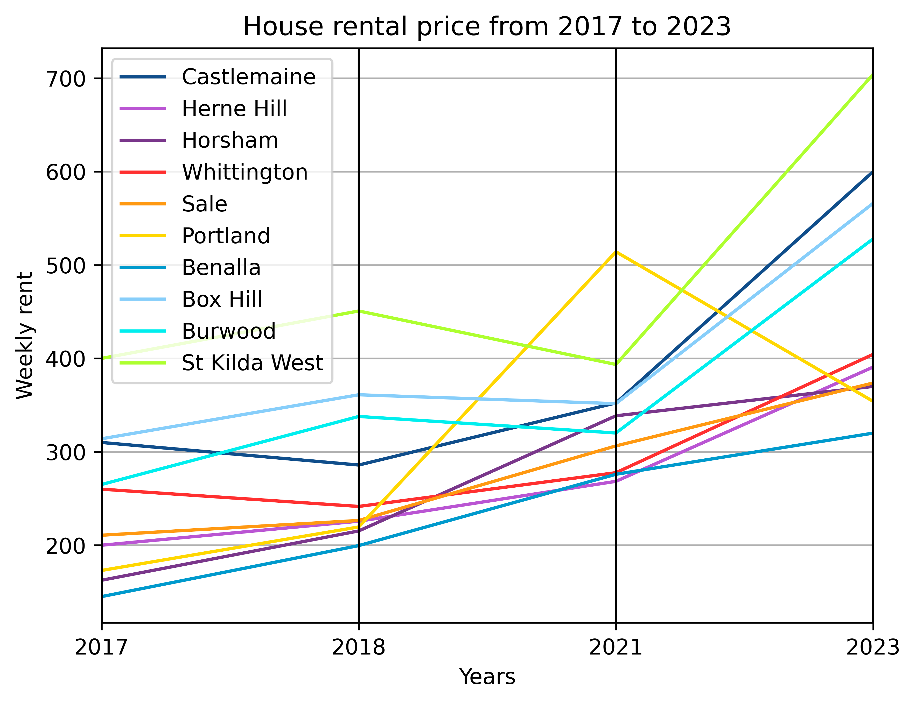
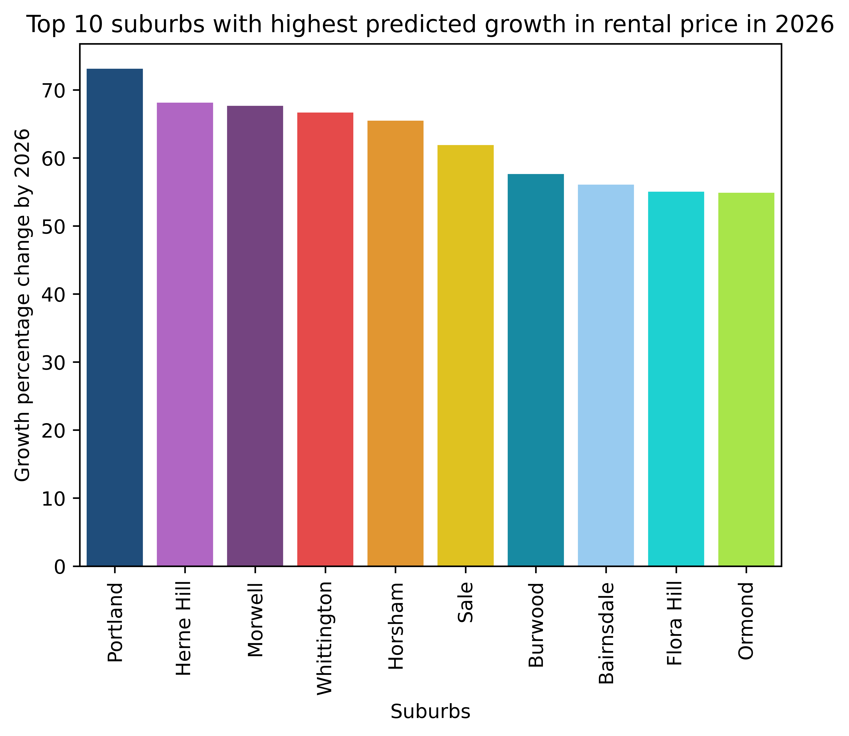
APARTMENT GROWTH
STATISTICS
Assumption: Previous years data is highly useful for forecasting future growth
MACHINE LEARNING
Overlapping Suburbs: Portland, Heme Hill, Burwood, Sale
Notes:
(15 sec)

Slide 16
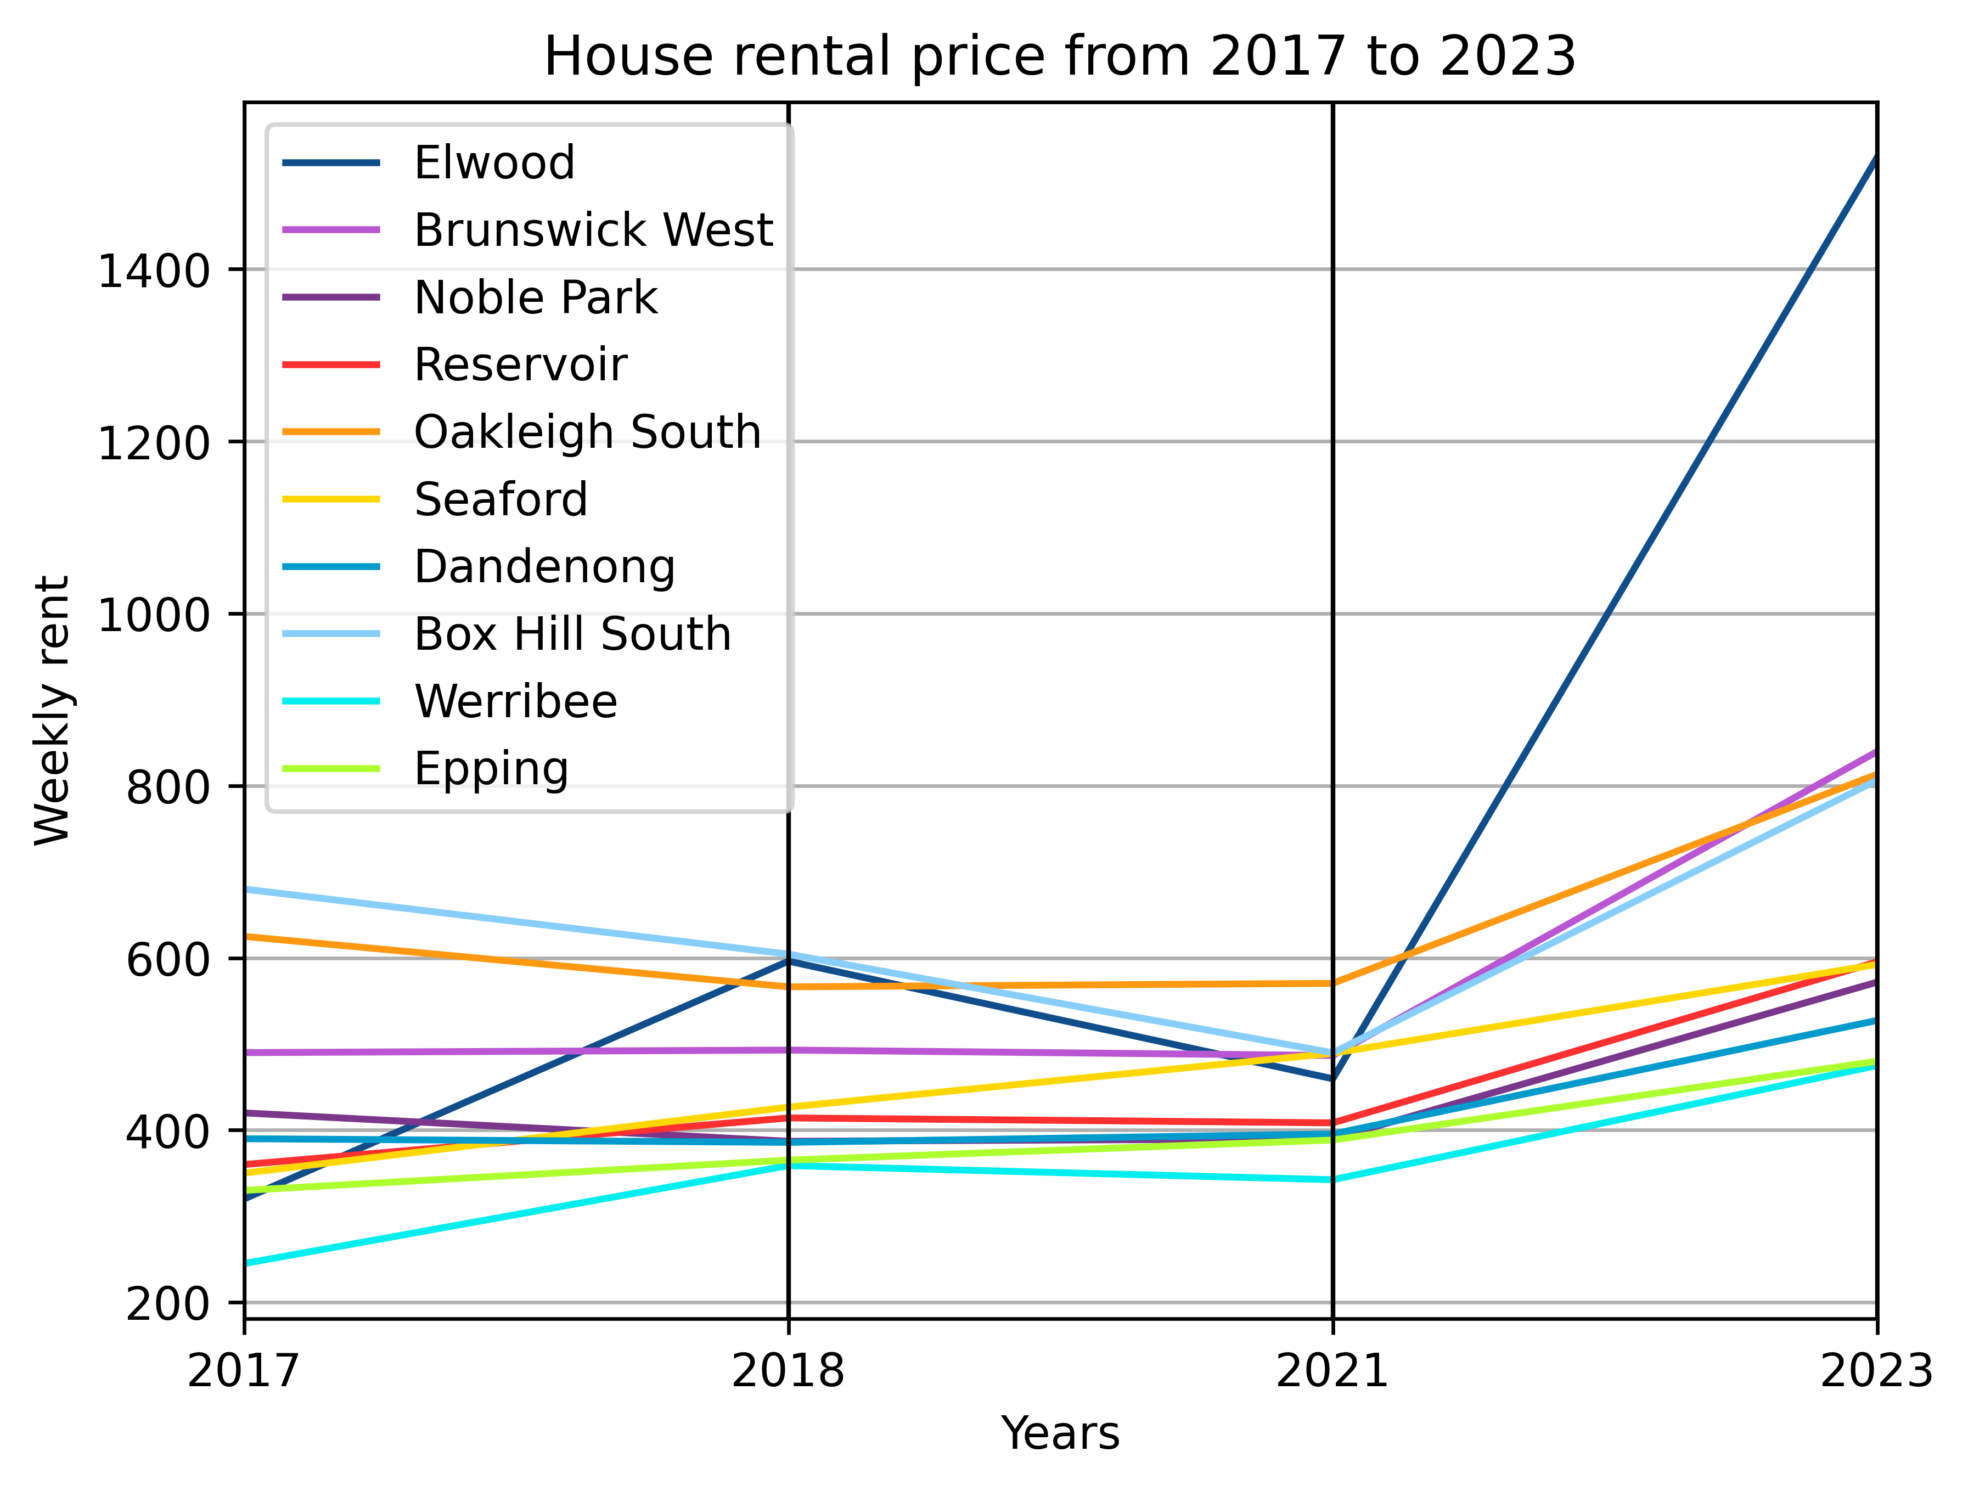
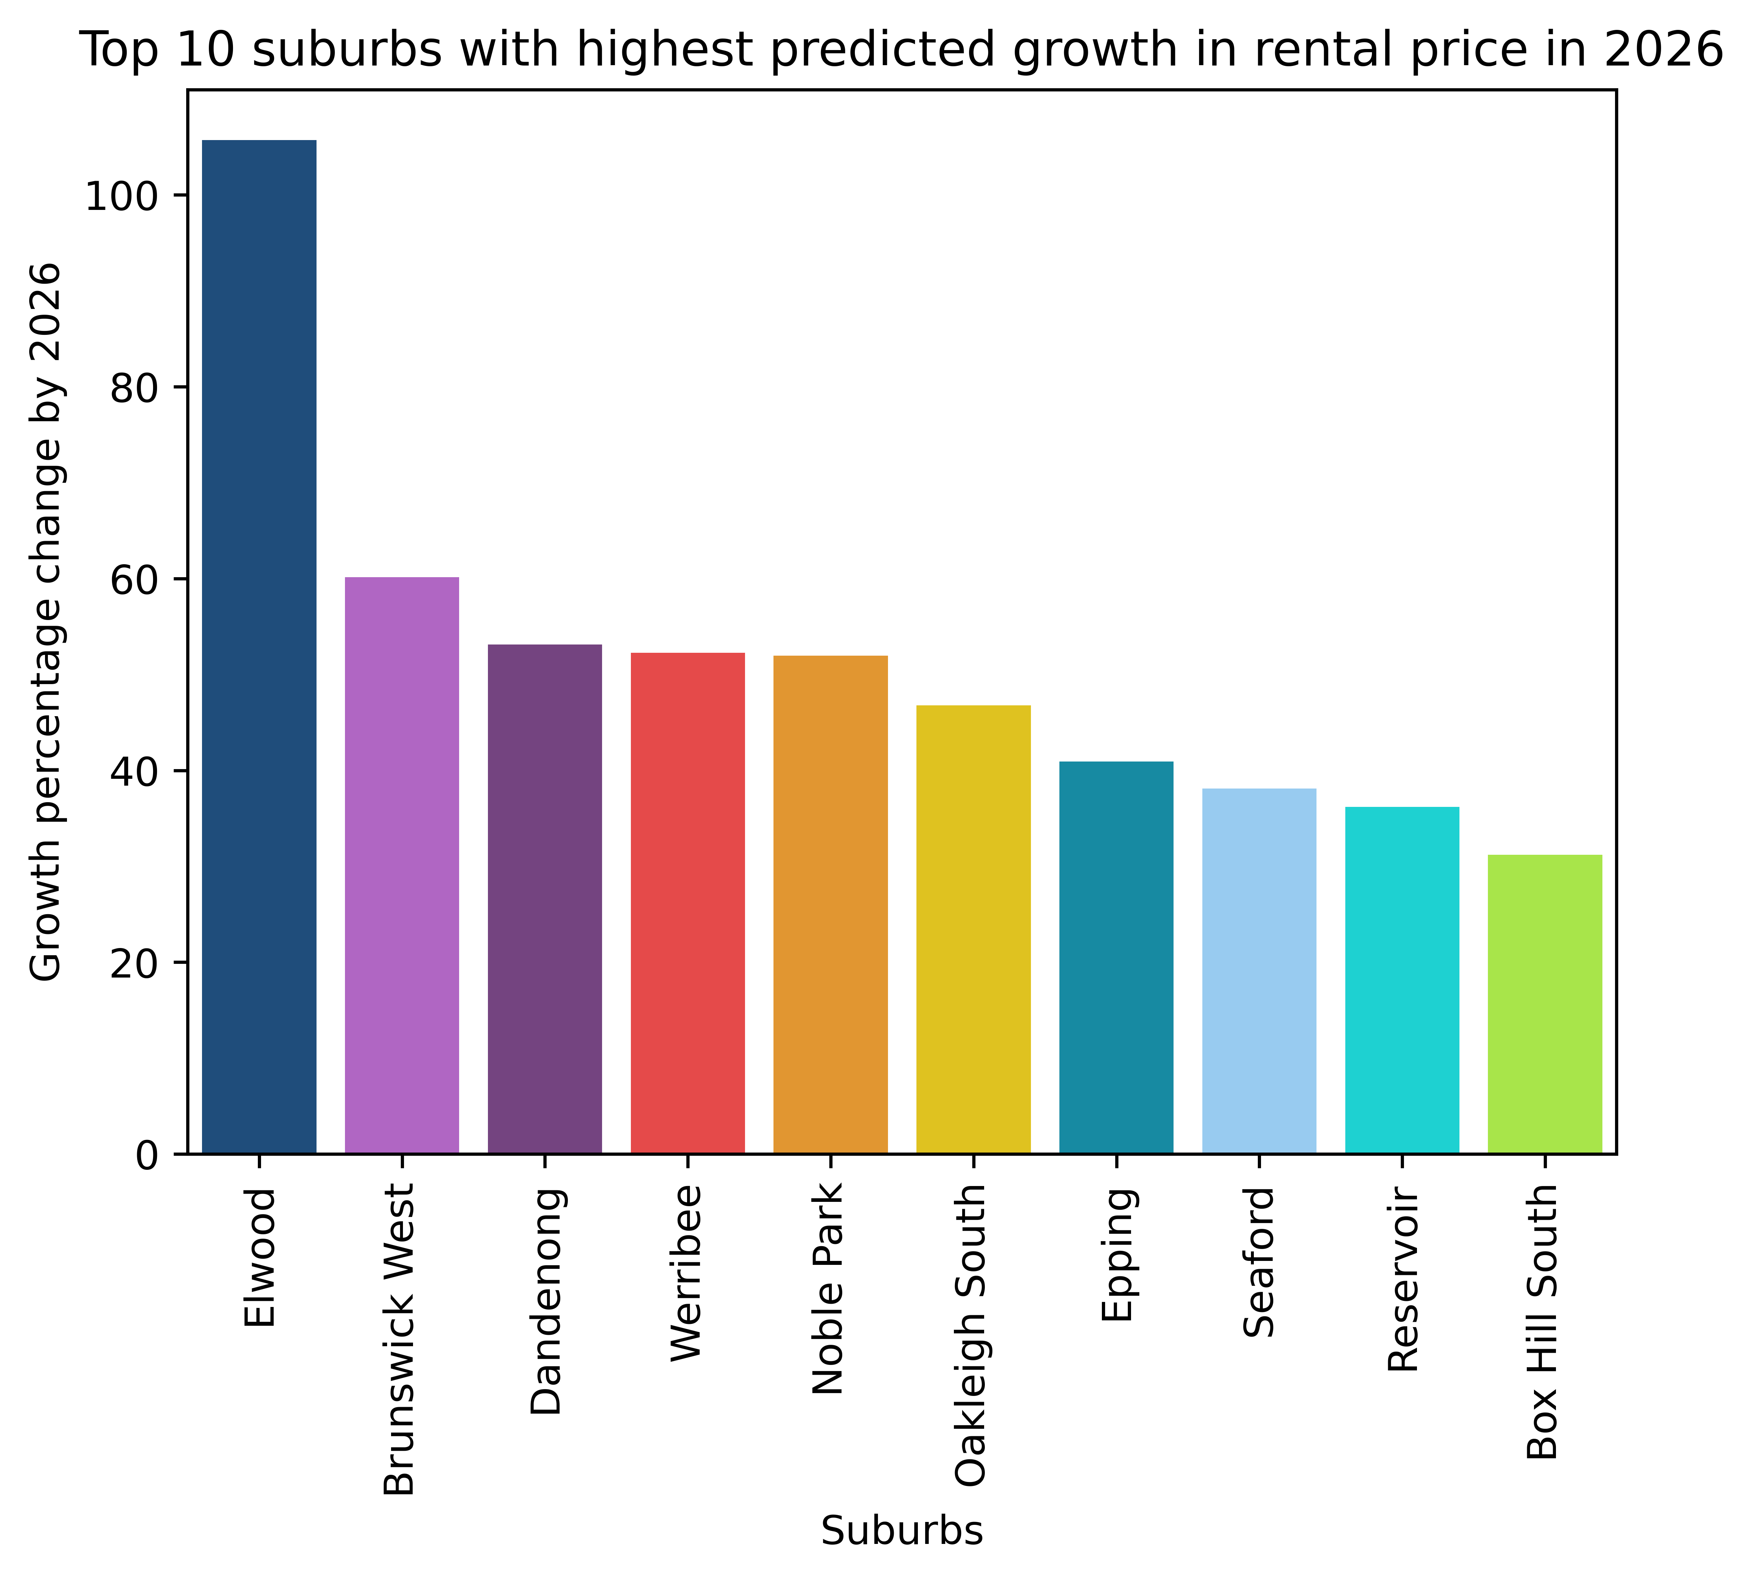
TOWNHOUSE GROWTH
STATISTICS
Assumption: Previous years data is highly useful for forecasting future growth
MACHINE LEARNING
Suggested: Elwood, Dandenong, Oakleigh South
Notes:
(Ngoc)
(10 sec)

Slide 17

Most Liveable & Affordable suburbs
Notes:
(Ingrid)
(2 mins)

Slide 18




LIVEABILITY
DEFINING LIVEABILITY
All our liveability factors are linked to the United Nations Sustainable Development Goals:
Access to healthcare and hospitals
Access to schools, childcares, and universities
Access to open and green space
Connectivity through public transport
Absence of crime
Notes:
We drew upon the method of liveability calculated by the Australian Urban Observatory.
This takes stock of all relevant United Nations Sustainable Development Goals which contribute to the everyday lives of residents, so all of our liveability factors are also linked to these. Each of these features was then standardised and given a weighting. For example the number of train stops has a higher weighting than the number of bus stops, given trains provide faster travel connections in to the city and surrounding suburbs. Crime was also given a negative weighting, given this is an undesirable feature. Each suburb was then assigned a liveability score out of 100, with the highest ranking suburb being 100 and the lowing given 0.

Slide 19
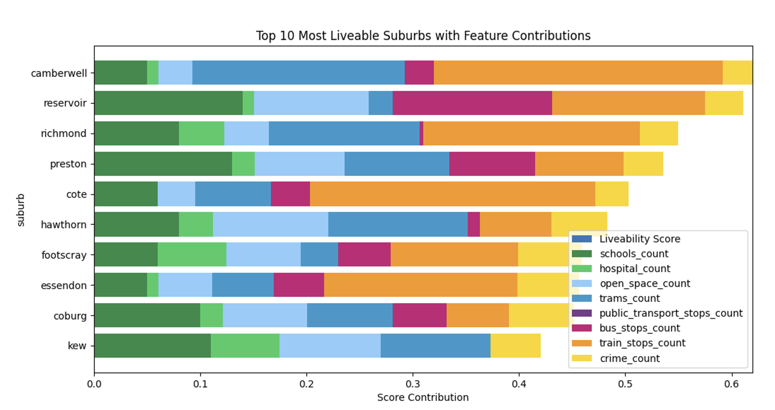
VICTORIA’S MOST LIVEABLE SUBURBS
Notes:
Camberwell has great connectivity, with train and tram stops contributing the most to it’s high liveability. Reservoir and Preston have lots of schools and open spaces, so are great places for families. All of the most liveable suburbs have low crime.

Slide 20

AFFORDABILITY
DEFINING AFFORDABILITY
‘The state of being cheap enough for people to be able to buy’
Cambridge Dictionary,2023,Affordability, https://dictionary.cambridge.org/dictionary/english/affordability
Notes:
Affordability must acknowledge income, and be relative to this.
Like the liveability calculation, the median rental price and median income were both standardised and given weightings.

Slide 21
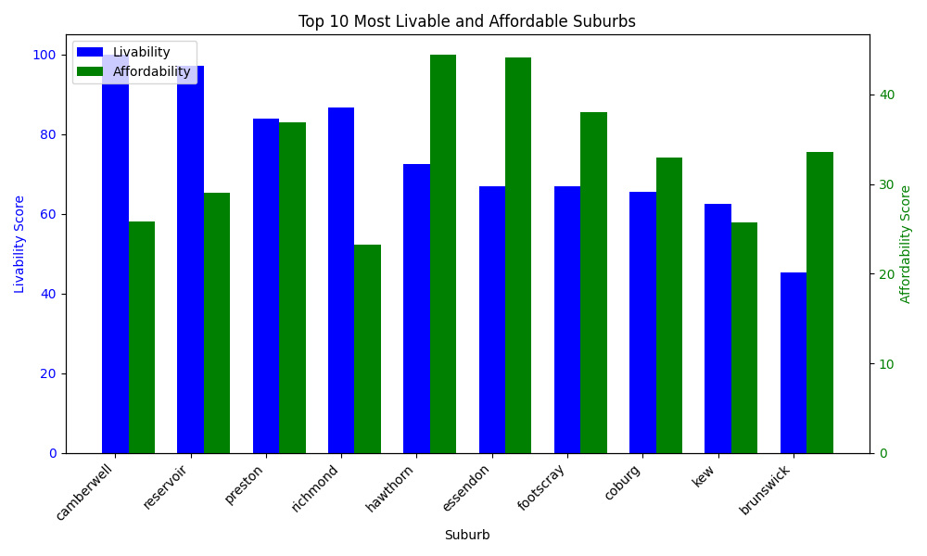
VICTORIA’S UNDERVALUED SUBURBS
Hawthorn, Essendon and Footscray are currently undervalued
Whilst being very liveable, renters will not tolerate further rental increases in Camberwell or Reservoir
Notes:
(Ingrid)

Slide 22

limitations and difficulties
Notes:
(Phoebe)

Slide 23




Data & Time limitations
Some datasets/features unable to be used due to missing data
Insufficient time to explore additional datasets/features
Insufficient time and data to use more complex models
Limited knowledge of future infrastructure
(upcoming public transport plans are not published)
API quota (1000 rows per day)
Notes:
(30 sec)
- some features unable to be used because too much missing data
Assumption that prices listed were the same amount as the actual lease contract
- Insufficient data and time to use more complex models
Time limitations: limited variables/datasets (finite exploration), model choice

Slide 24

Final Recommendations

Slide 25
FINAL RECOMMENDATIONS
Significant factors in predicting rental price:
Distance to CBD Postcode
No. of Bedrooms Income
Recommendations:
When client is leasing property:
Predict possible demographics of interested parties based on first 3 factors
Determine weekly rent price based on possible interested demographics
Top 3 suburbs by growth:
House: Docklands, Nhill, Meeniyan
Apartment: Portland, Burwood, Box Hill
Townhouse: Elwood, Dandenong, Oakleigh South
Recommendations:
For investors:
Most profitable to invest in houses and apartments in the aforementioned suburbs
For clients living in the above suburbs and planning to sell:
Delay selling property (if possible)
Rent out property instead
Affordability and Liveability Recommendations:
When client is leasing property:
Rental prices in Hawthorn, Essendon and Footscray should be revised and brought in line with current market conditions
Camberwell and Reservoir rent should not be lifted, at risk of renters looking elsewhere
Notes:
(1 min 10)
Significant factors:
Top suburbs by growth:
Investors -> houses/apartments represent largest proportion of housing market

Slide 26
FEASIBILITY OF PROJECT
CURRENT VALUE PRODUCED (within 6 weeks)
Insights
Understand determining factors of rental price
Suburbs rising in price and potential reasons
Most liveable and affordable suburbs
Quality of Model
Performing well (low error), despite simplicity of model
POTENTIAL VALUE FOR FUTURE EXPLORATION (total project length ~ 3-4 months)
Other Features
Consider other economic factors: expected future dwellings, expected net immigration, interests rates, gov. incentives
Granularity
Instead of using affordability based on average income, divide population into different categories by income, then determine affordability for each of these groups
Model Choice
Deep Learning Time Series forecasting: Transformer-based models (eg. Autoformer, N-BEATS)
Notes:
(Phoebe)
(1 min)
Model choice:

Slide 27
THANK YOU!

